Slide 1
Customer Segmentation using RFM Analysis & CLTV Estimation
Group: 8
Shashank Gupta | Nikhil Chavan | Jay Trivedi | Charu Joshi

Slide 2
Problem Statement
An e-commerce company wants to segment its customers and determine marketing strategies according to these segments. For example, it is desired to organize different campaigns for new customers and different campaigns to retain customers that are very profitable for the company. We are predicting customer’s lifetime value and segmenting them based on their LTV.

Slide 3
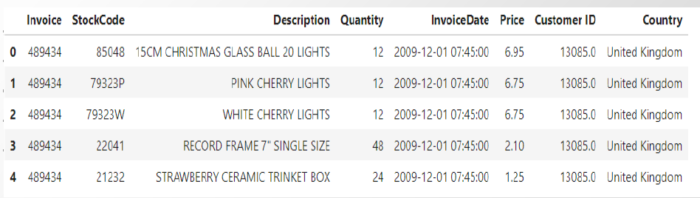
Dataset background and Variables
The data source is available at UCI repository and Kaggle.
The dataset includes actual transaction of an e-commerce retail store.
The dataset contains over 1 million rows and 8 attributes - Invoice Number, Stock Code, Product Description, Product Quantity, Invoice Date, Unit Price, Customer ID

Slide 4
Customer lifetime value (CLV)
The lifetime value of a customer, or customer lifetime value (CLV), represents the total amount of money a customer is expected to spend in business, or on products, during their lifetime. It is the net profit acquired from a customer throughout a company’s relationship with them.
Knowing each customer’s customer lifetime value helps you know how much you should be spending on customer acquisition. A customer’s acquisition cost could be more than what they spend on their purchase, but if you nurture that relationship, their CLV may grow to an amount that’s well worth the investment. That’s just one of the many reasons why success in the customer-centered economy means understanding the importance of customer lifetime value.

Slide 5
Why CLTV is important?
CLV tell marketers, how much revenue they can expect from one customer over the course of the business relationship. The longer a customer continues to purchase from a company, the greater their lifetime value becomes.
CLV-based Customer Segmentation helps with more effective segmentation. Clusters of customers can be identified based on the long-term revenue potential of a customer. Customized offers & products can be designed to unlock maximum customer value.
CLV is one of the key metrics to track the performance of the company as compared to the competitors.
We have estimated CLTV with NBD & Gamma Gamma Models. Built models with the past shopping habits of the users, predicting our most profitable customers and the CLTV values of our customers. Customer segmentation by means of unsupervised machine learning is performed in order to show an efficient tool for strategy planning.

Slide 6
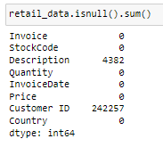
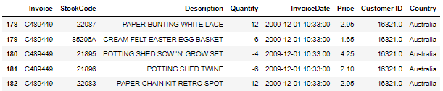
Data Processing
Removing Null Values
Removing Cancelled Orders

Slide 7
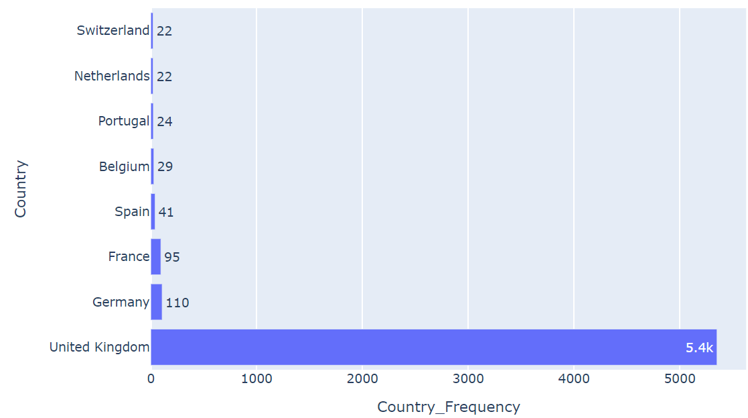
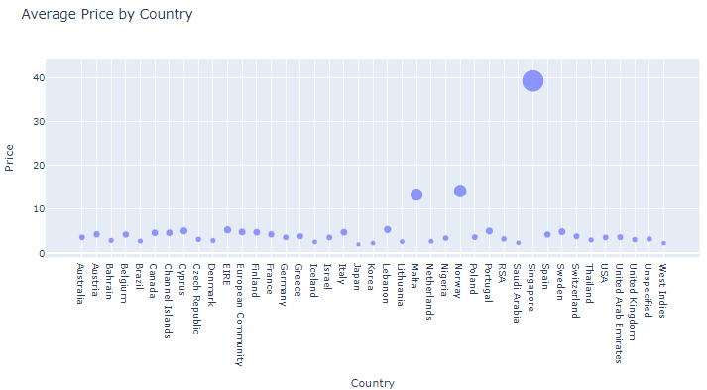
Exploratory Data Analysis
Customer Frequency by Country
Average Pricing (in USD) of Product by Country
Findings:
Majority of Customers reside in UK
Average Price is high for Singapore, Norway, and Malta (In DESC Order)

Slide 8
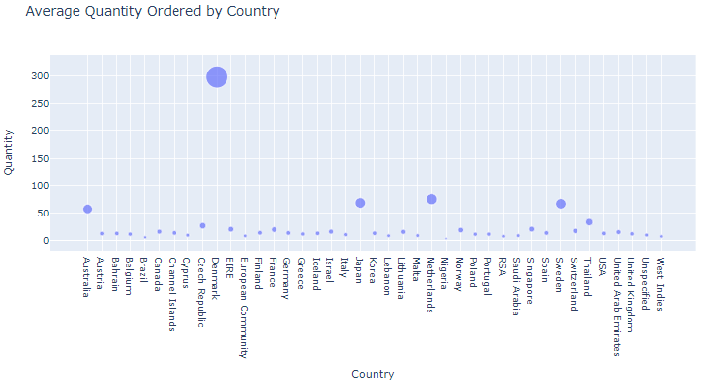
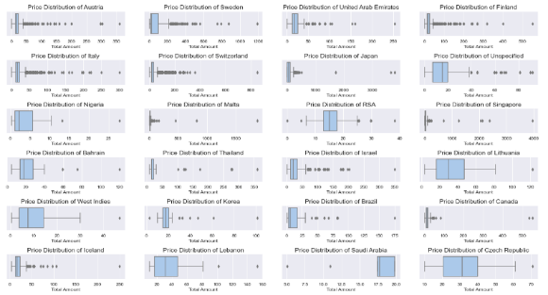
Exploratory Data Analysis(Cont.)
Average Quantity of Product ordered by Country
Boxplot of Price (in USD) for each Country
Findings:
Average Quantity is high for Denmark, NL, Sweden, and Japan (In DESC Order)
Pricing Boxplots shows Outliers for several Countries.

Slide 9

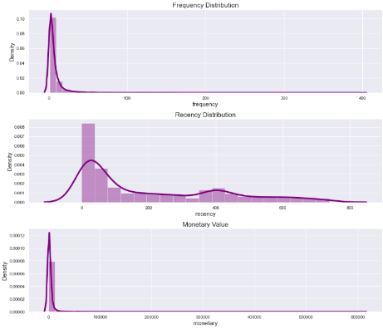
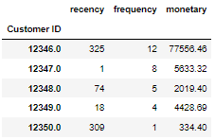
RFM Analysis
Recency: When is the last time customer ordered / Visited the store?
Frequency: How many times Customer has visited the store?
Monetary Value: What’s the total Spending by the Customer

Slide 10
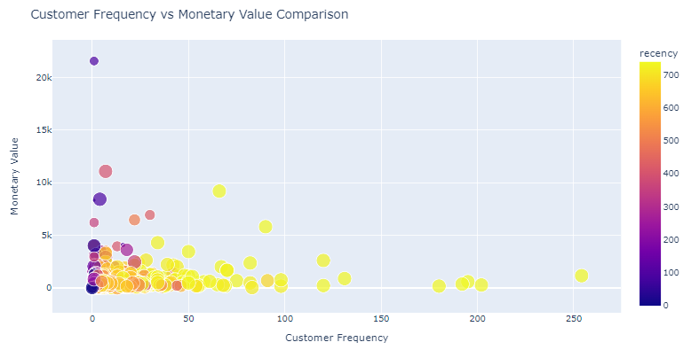
Visualizing RFM Features

Slide 11
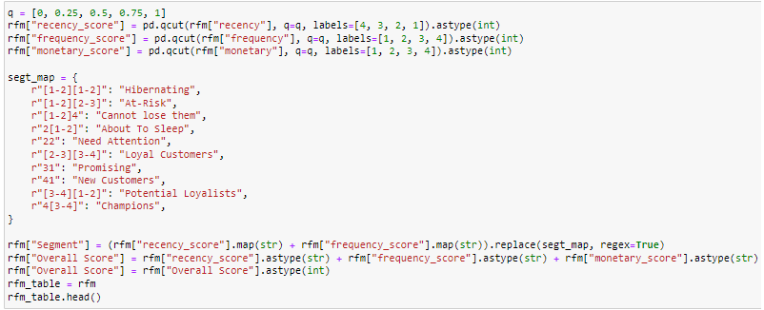
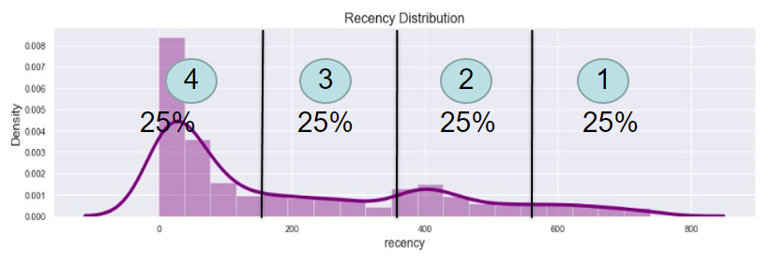
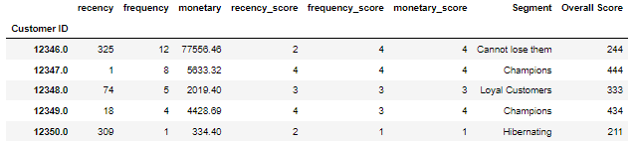
Customer Segmentation using RFM

Slide 12
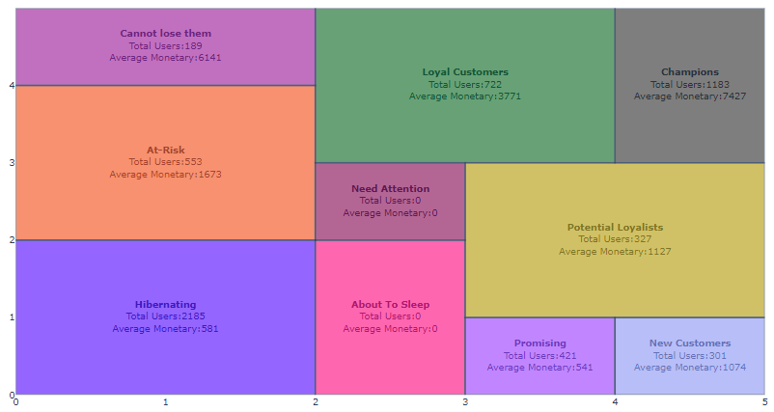
Customer Segmentation using RFM (Cont.)

Slide 13
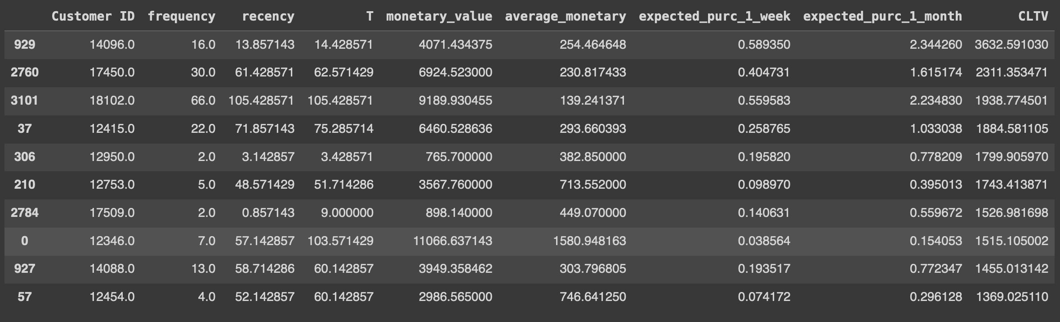
Customer Segmentation using CLTV
how much a business can plan to earn from the average customer over the course of the relationship ?
We are using BetaGeoFitter from lifetimes library to estimate expected purchase within 1 week and 1 month
GammaGammaFitter to estimate the CLTV
T defines age of a customer

Slide 14
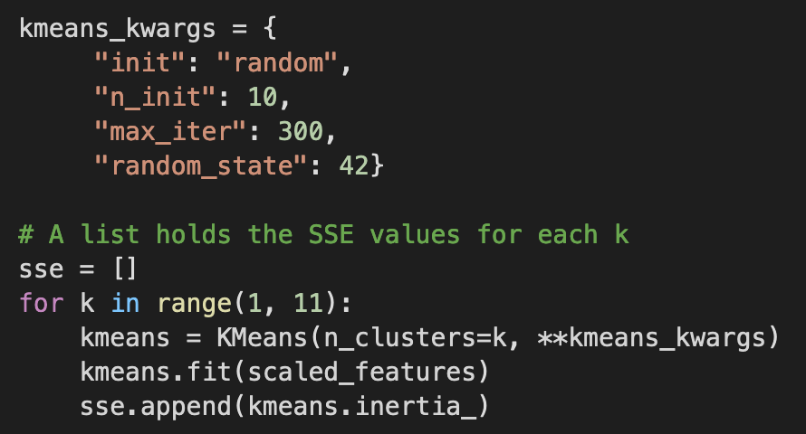
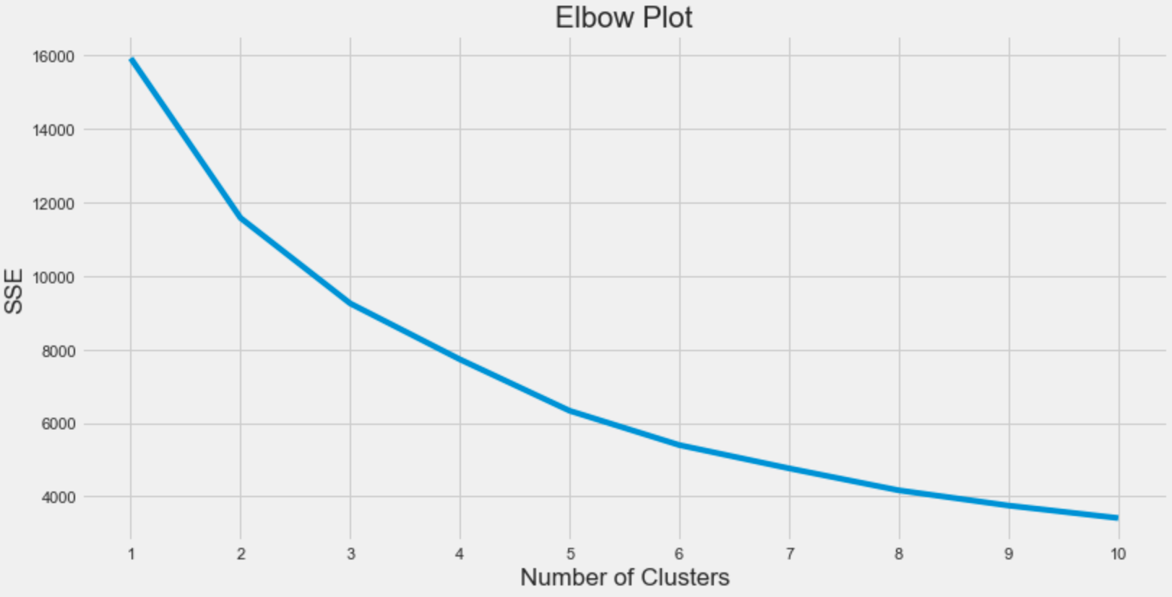
K-means clustering
Elbow Criterion Method
Plot the number of clusters against within-cluster sum-of-squared-errors (SSE) -sum of squared distances from every data point to their cluster centers.
Elbow - a point representing an "optimal" number of clusters
We used knee_locator from kneed library to determine the optimal number of clusters
5 – is the optimal number of clusters

Slide 15
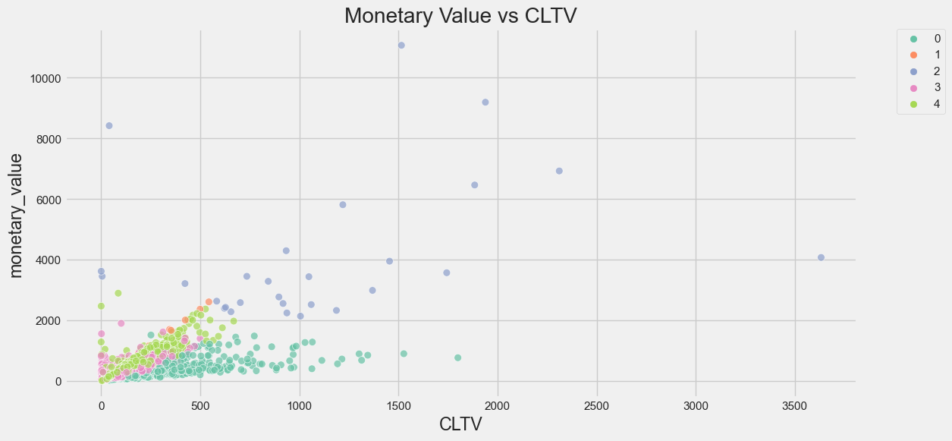
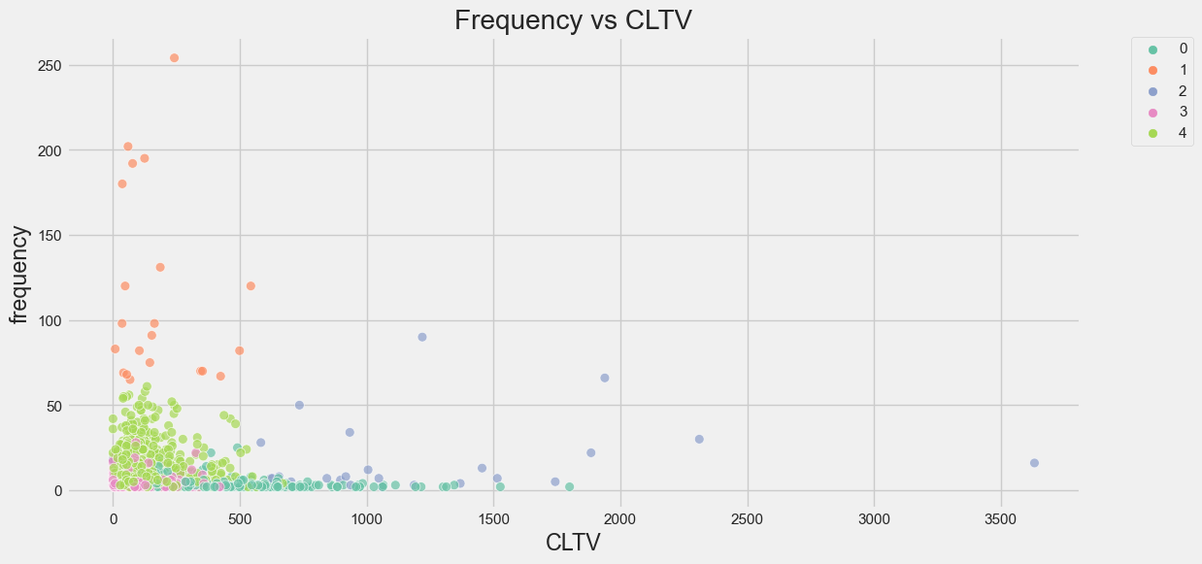
Visualizing Customer Clusters

Slide 16
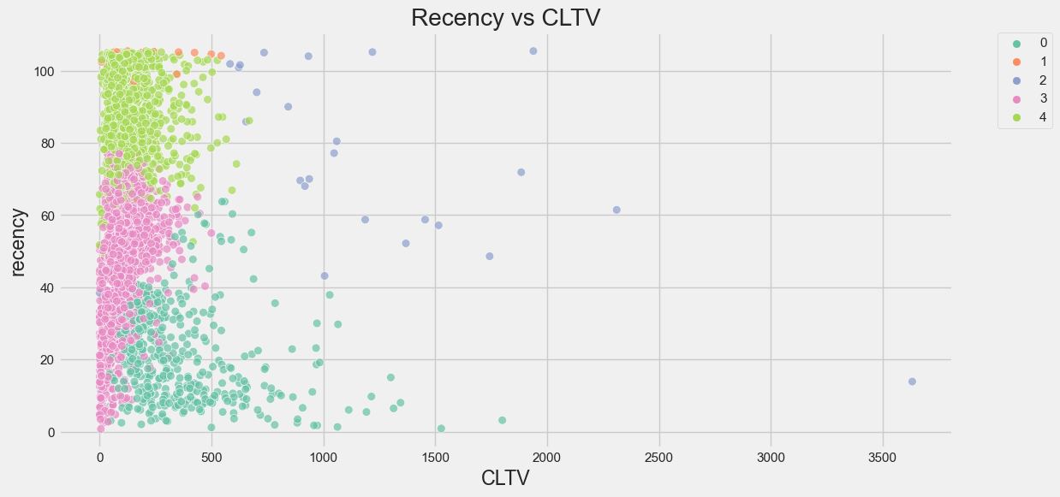
Key Takeaways
Cluster 1 (Blue Colour) seems to be performing well in terms of Monetary Value and Frequency but not in Recency.
Scatter plot between Monetary Value and CLTV shows a linear relationship.

Slide 17
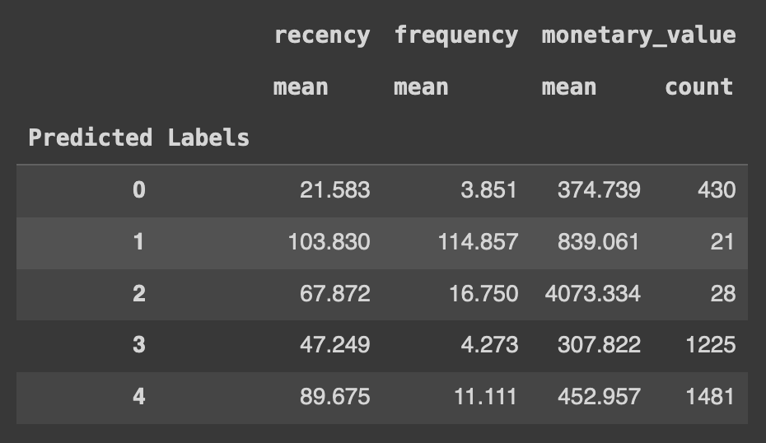
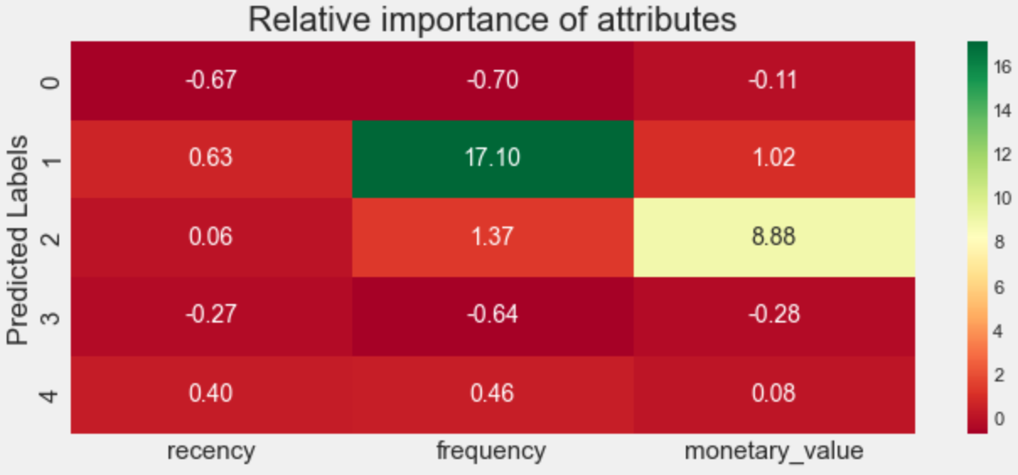
Relative importance of segment attributes
Useful technique to identify relative importance of each segment’s attribute
Finally, we can assign priority to different clusters of customers using the above heatmap

